Slide 1
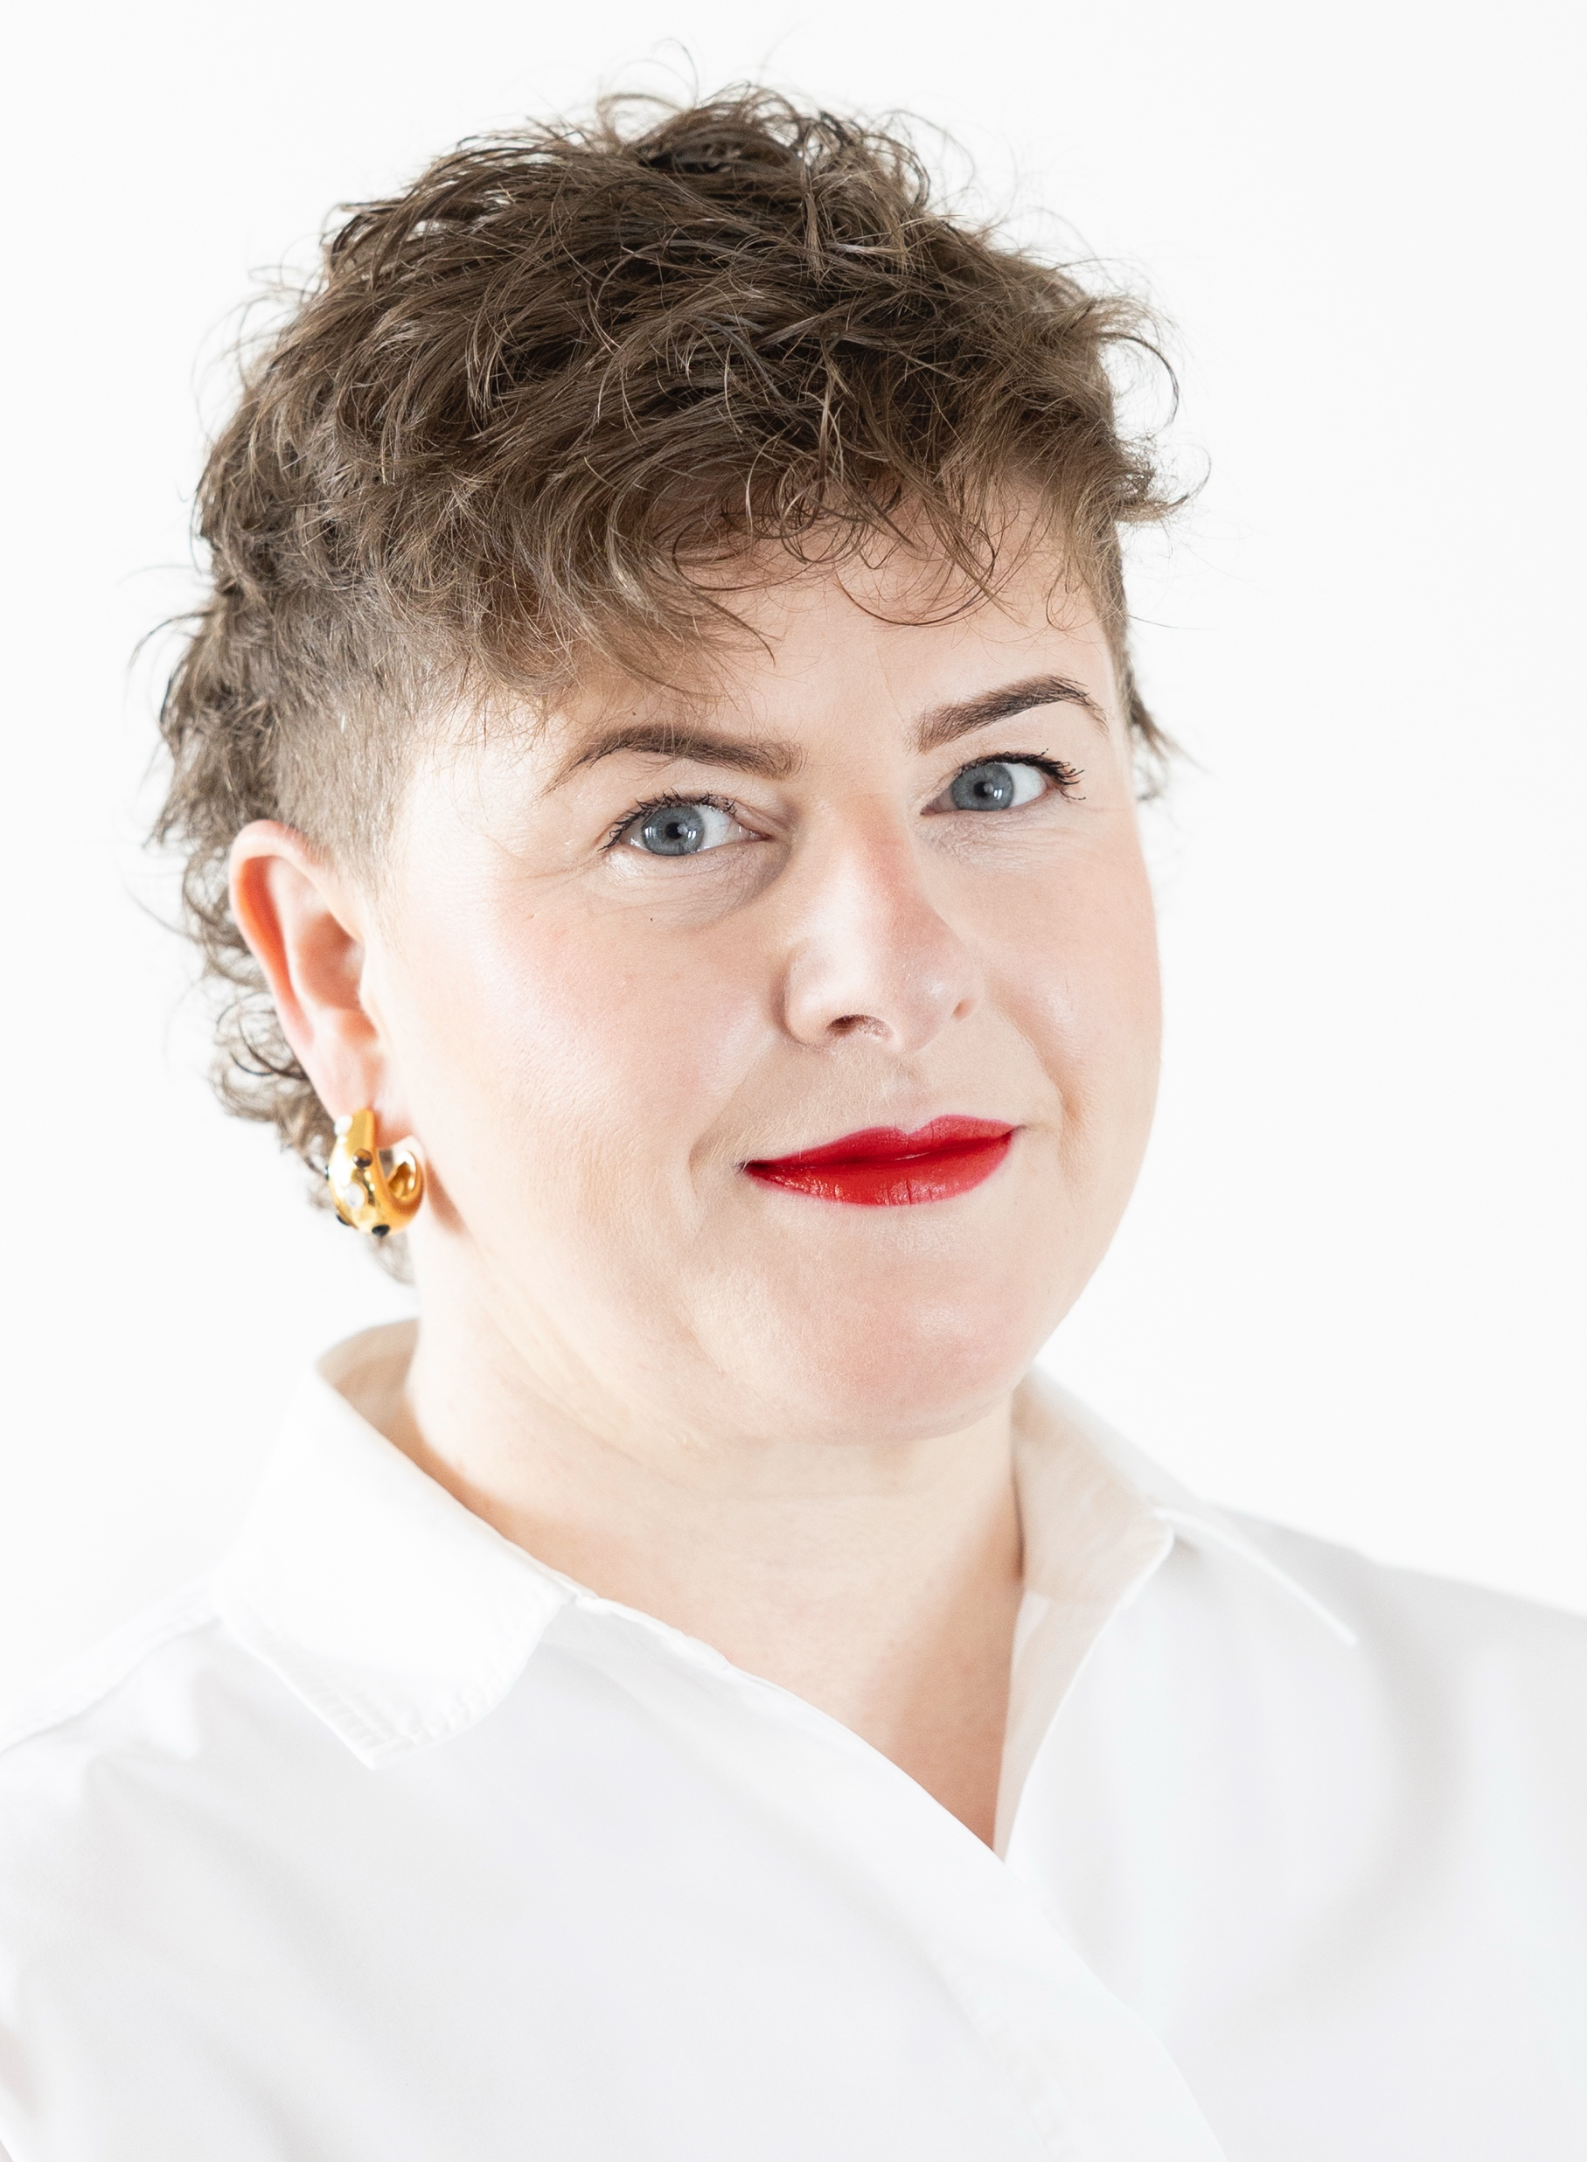

Reflex testing for BRAF in Melanoma in Greater Manchester.
A project on behalf of GM Cancer
Dr Lynne A Jamieson
Consultant Dermatopathologist
NCA

Slide 2

Reflex testing for BRAF in Melanoma in
Greater Manchester
A project on behalf of GM Cancer

Slide 3
Reflex testing for BRAF in Melanoma in
Greater Manchester
A project on behalf of GM Cancer

Slide 4
Who is this video for?
Pathologists
Pathology
managers
LSMDT
Do you diagnose primary melanoma ?
Do you diagnose metastatic melanoma ?
Even if rarely then this video is for YOU!
Do you manage a pathology service ?
Do you outsource skin cancer reporting?
You need ensure testing is happening – this video is for YOU!
Are you a member of a skin cancer MDT?
Irrespective of your role, this video is for YOU!

Slide 5
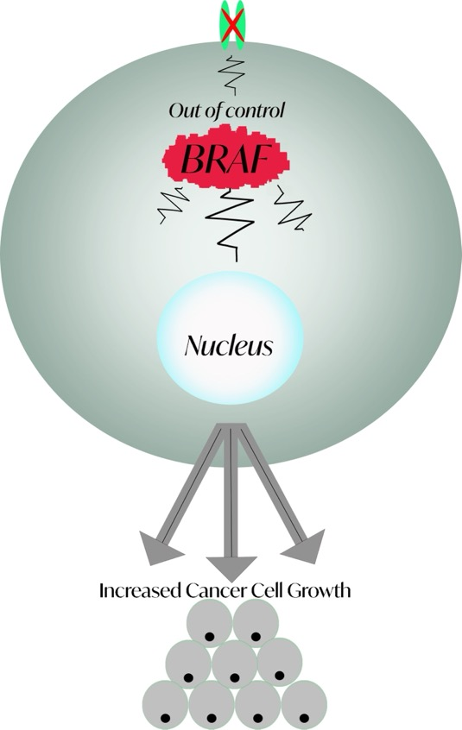
What is a BRAF mutation?
MAPK signalling pathway which controls cell growth.
Mutant BRAF which is part of the pathway leads to out-of-control cell growth and in some cases melanoma.
A BRAF mutation is present in approx. 50% of melanomas.
90% BRAF V600E – other BRAF mutations can be present eg BRAF V600K.

Slide 6
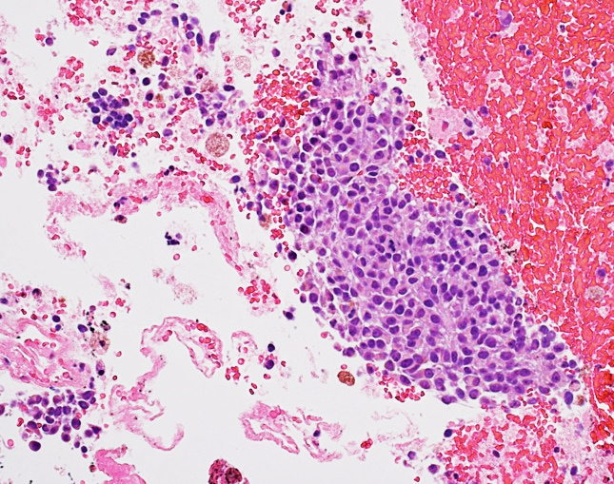
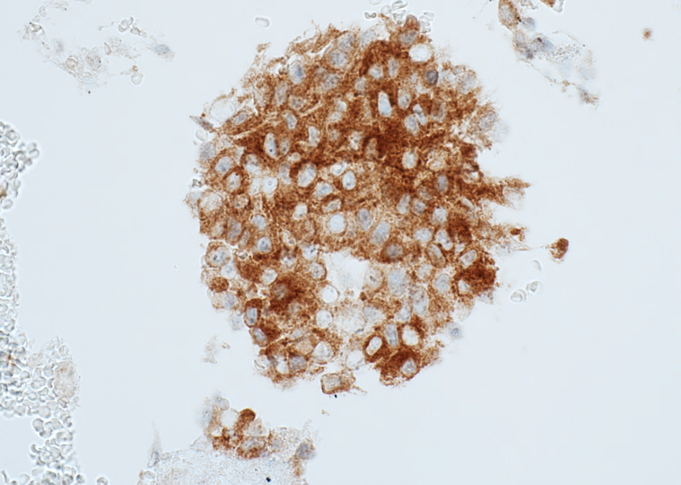
How do we test?
BRAF V600E immunohistochemistry.
Available in GM at:
Salford Royal Hospital
Christie Hospital
Can be done as part of melanoma panel during work up.
Positive or negative result.
Can be done on cytology specimens.
If negative – requirement to send tissue for
molecular genetics.

Slide 7
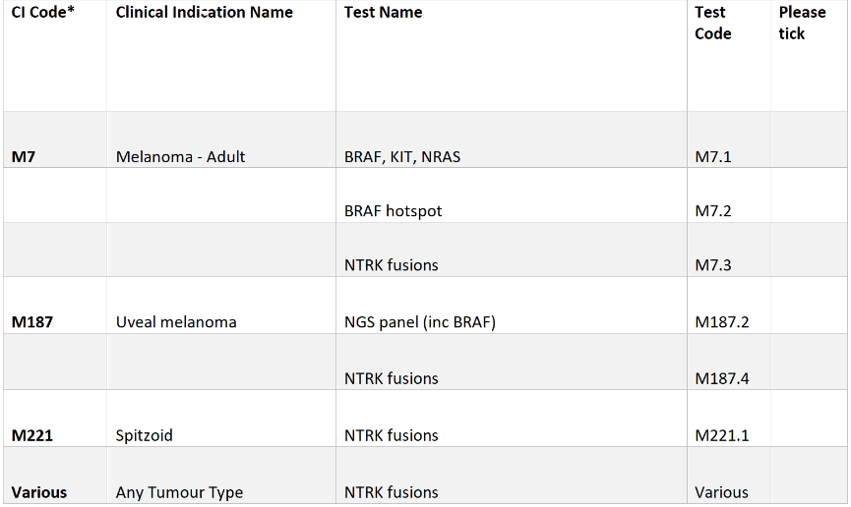
Molecular testing – Manchester GLH
Tick box M7.1 for Adult melanoma :
BRAF, NRAS and KIT.
If tumour percentage below 20% - mark slide.
In future the CPGC will make this job easier. Easiest done at time of reporting.
✔️

Slide 8
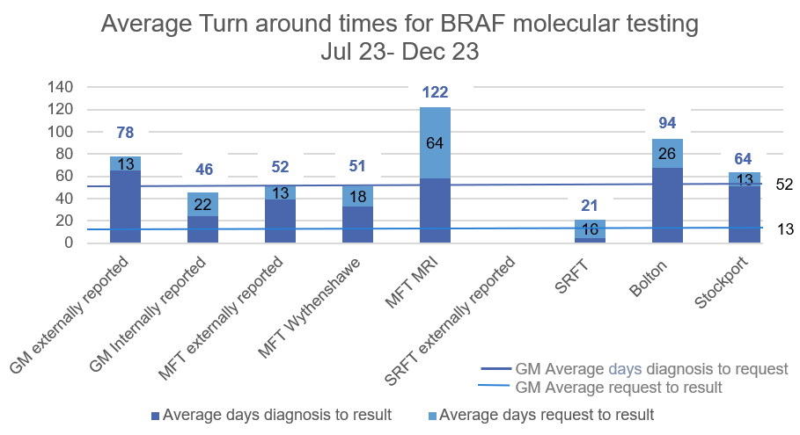
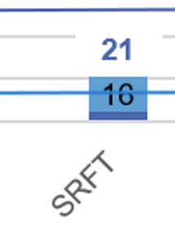
What have we been doing in GM?

Slide 9
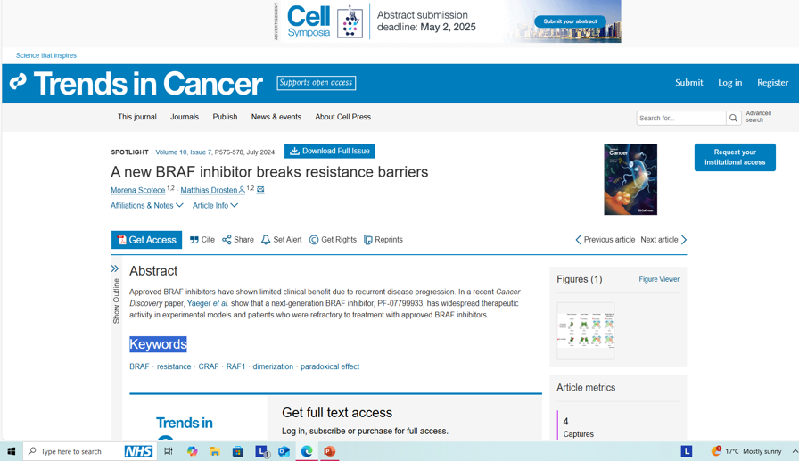
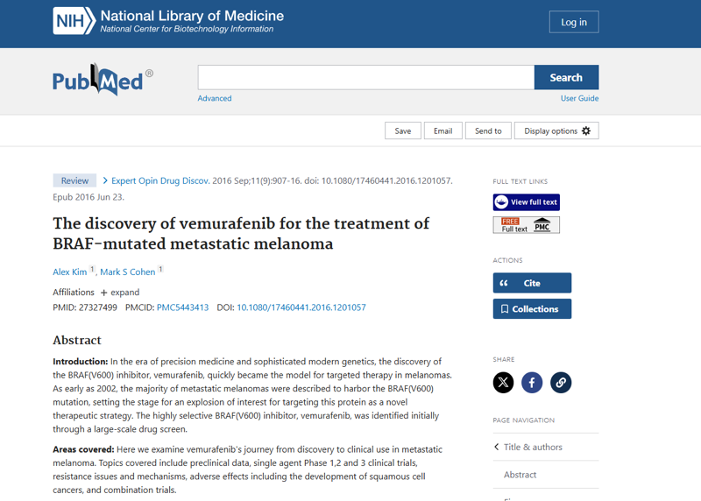
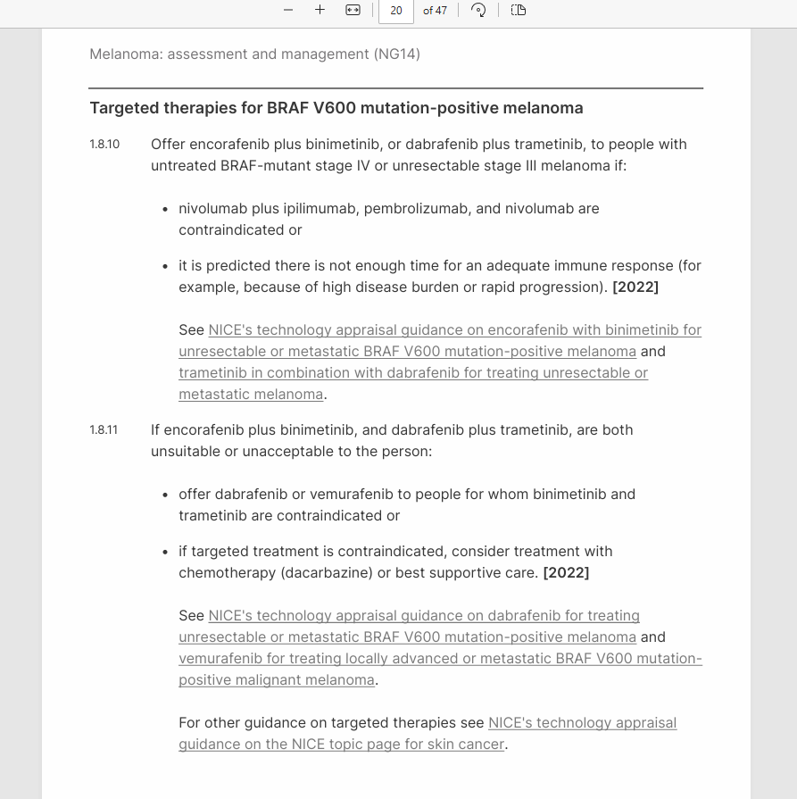
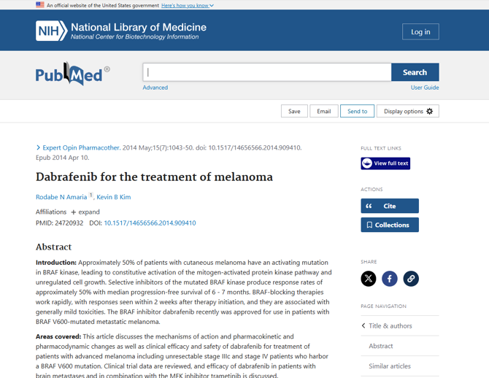
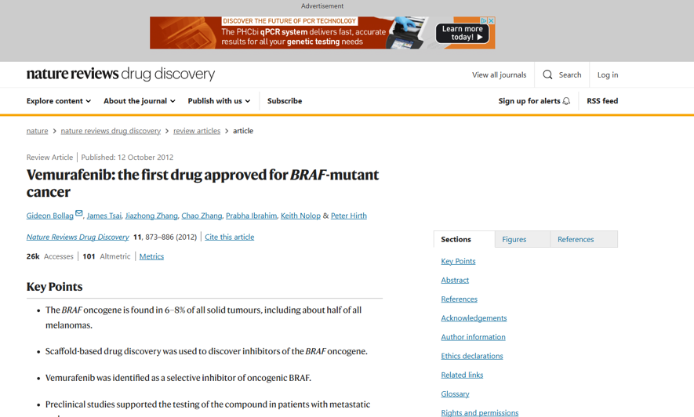
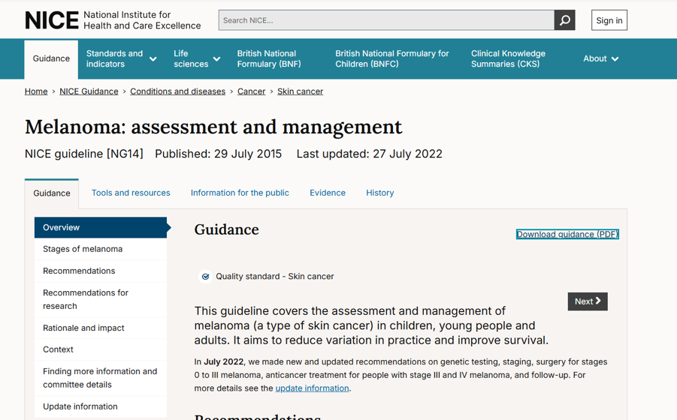
Why it is important…
Drug therapies – Vemurafenib, Dabrafenib
Guidance - NICE
  Immunohistochemistry for BRAF V600E
  Molecular genetics – NGS/COBAS
  WHY is it urgent- can’t it wait until we know the patient has metastatic disease and needs the treatment?
Why it is important…

Slide 10
WHY?
Because Jackie says so!
Jackie Hodgetts
Specialist Nurse at the Christie Hospital
Faces these scenarios on a regular basis.
150 new referrals per year of
patients with advanced melanoma requiring oncological management by medical oncology.
We know that >50% of patient do not have BRAF status established at time of referral.
Testing delayed due to not knowing where the sample is, finding it, getting the tissue from deep store and getting it sent for testing.
Increased patient anxiety as they do not know if eligible for trials and disappointment when not.
Delay in planning treatment regime – what will be the second line treatment if this one fails?
Delay in receiving treatment in life threatening situations due to waiting on test results e.g. brain or spinal metastasis.

Slide 11


Who do we test?
NICE Guidance tells us:
1.3.9 Consider BRAF analysis of melanoma tissue samples from people with stage IIA primary melanoma. [2022]
1.3.10 Carry out BRAF analysis of melanoma tissue samples from people with stage IIB to IV primary melanoma. [2022]
These clinical stages equate to pathological stage pT2b or higher or a lower stage with microsatellites or clinically apparent metastatic disease).
Or metastatic deposits - from any site!

Slide 12
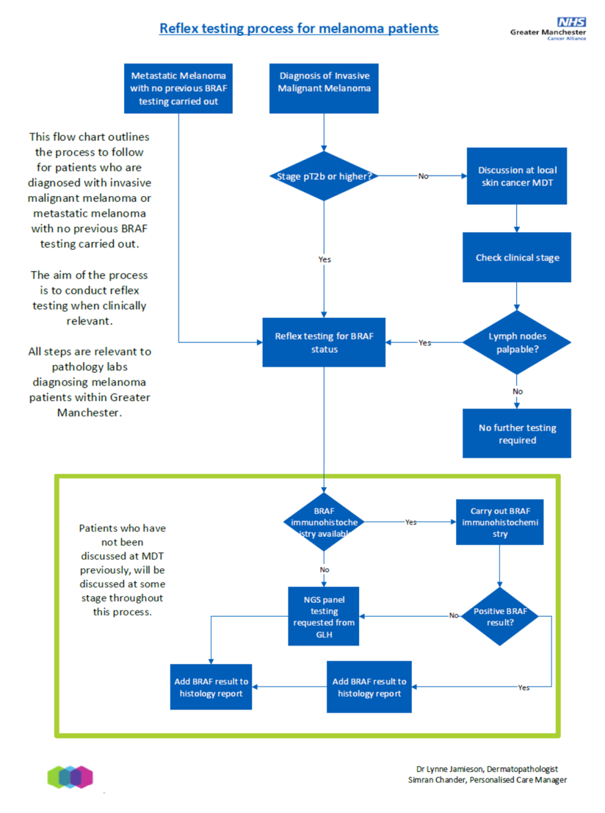
Reflex
Testing
Process
For
Melanoma
Patients.

Slide 13
Please Test…
When you make the diagnosis:
At LSMDT:
If you have access to BRAF immunohistochemistry
  Salford Royal Hospital
  Christie Hospital
  If IHC is negative – send to GLH for molecular testing.
Check the pathology report to ensure the result is there.
Ask pathologist if test has been sent.
Ask the pathologist to test.
Record status as an outcome.
Chase results to ensure the status is in patient record.

Slide 14
Please remember:
Reflex testing for Melanoma in Greater Manchester
BRAF…NO FAFF!

Slide 15
With thanks to…
Lisa Heyes, Personalised Care Manager, GM Cancer
Simran Chander, Personalised Care Manager, GM Cancer
Dr Rhian Davies, Resident Doctor, Histopathology
Dr Ruth Green, Consultant Dermatopathologist, Salford Royal Hospital
Jackie Hodgetts, Specialist Oncology Nurse, The Christie Hospital
Dr Avinash Gupta, Consultant Oncologist, The Christie Hospital
Nadia Ali, Specialist Melanoma Pharmacist, The Christe Hospital
GM pathology Departments

Slide 16

Any Questions?
Please direct them to: lynne.jamieson@nca.nhs.uk

