Slide 1

The CURE Project Overview
Freya Howle
CURE Programme Lead
Dr Matthew Evison
CURE Clinical Lead
© Copyright Greater Manchester Cancer. All rights reserved.

Slide 2


The CURE Project
What is it?
The CURE project is implementing a standardised tobacco addiction treatment pathway for all inpatients admitted to hospital by:
Screening all patients for smoking status on admission
Offering VBA and immediate treatment
Offering an opt out specialist assessment, behavioural support and treatment planning throughout admission
Ensuring referral to appropriate follow up on discharge
GM Cancers Ambition
Ensure tobacco addiction treatment services are available for inpatients admitted to ALL hospitals in GM
Reduction in readmission
Reduction mortality
Numerous health benefits for the GM population which would positively impact every element of healthcare
Smoking is the single greatest cause of preventable death, disability, illness and social inequality.
Concentrated population of smokers
Sick smokers
Teachable moment
Motivation
Effective mitigation of withdrawal
Effective long term treatments
Immediate benefits to the patient, hospital and society
20,000 smokers in hospital on any given day in the UK 1 million smokers admitted to hospital at least once each yr.Smokers are 36% more likely to be admitted to hospital
@GM Cancer I GM Cancer Board – Spotlight Update May 2021

Slide 3
GM rollout – what have we achieved?
The CURE Project has now successfully launched in all 7 of the phase 1 hospital sites in GM as of the 14th September 2020 (Oldham, Salford, Bury & Rochdale, Wigan, Tameside & Stockport).
Within each locality we have worked with many stakeholders across secondary and primary care to ensure a successful launch of a new treatment pathway for all smokers admitted to hospital.
X17 new CURE team members have been recruited across GM to 1 year contracts – Specialist nurses, advisors and administrators.
The CURE website has had over 1.5million visitors since launching in 2018 – Royal Liverpool University Hospital & Leighton Hospital (MCHT) are both delivering the CURE model with over 10 other hospitals/regions using key aspects of the model to set up and deliver acute care based services.
The CURE Nursing Teams across GM have come together for several Specialist Networking days to share best practice and learning, as well as to support each other though a challenging time for face to face services.
Along with the Smokefree Pregnancy Programme our CURE Programme Lead is working in an advisory role with NHSE&I on delivery of the Prevention element of LTP – focusing on delivery of tobacco addiction services in acute, maternity and mental health services by 2023/24.
@GM Cancer I GM Cancer Board – Spotlight Update May 2021

Slide 4
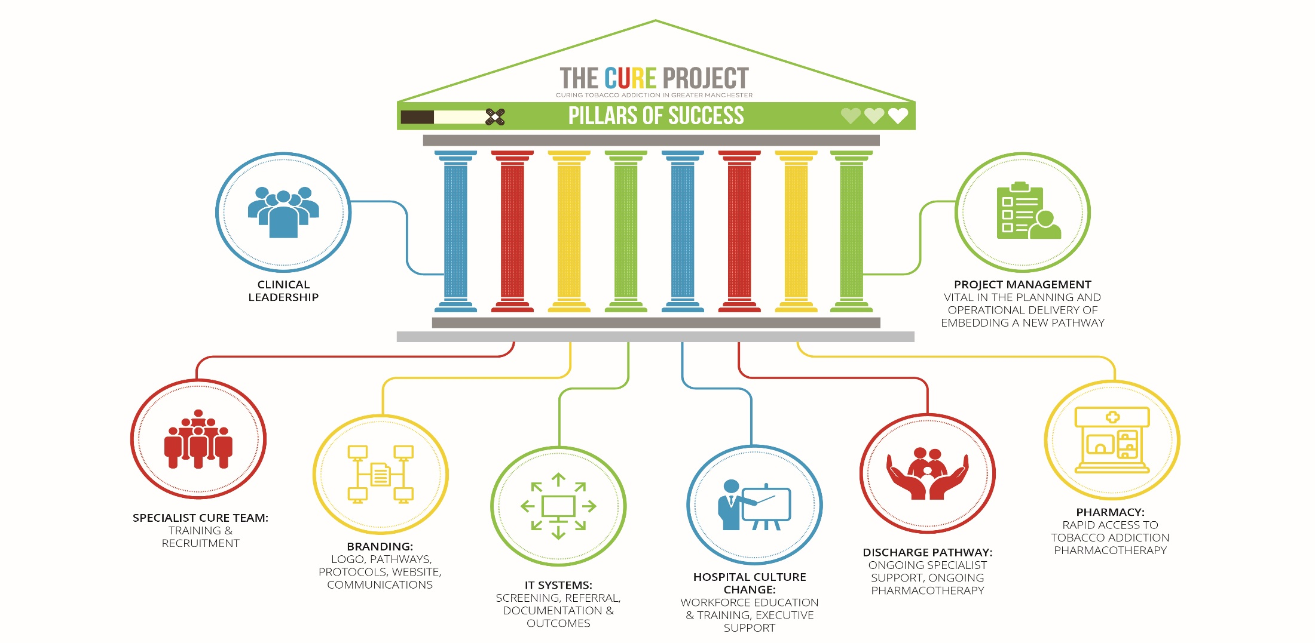
Implementing CURE – pillars of success

Slide 5
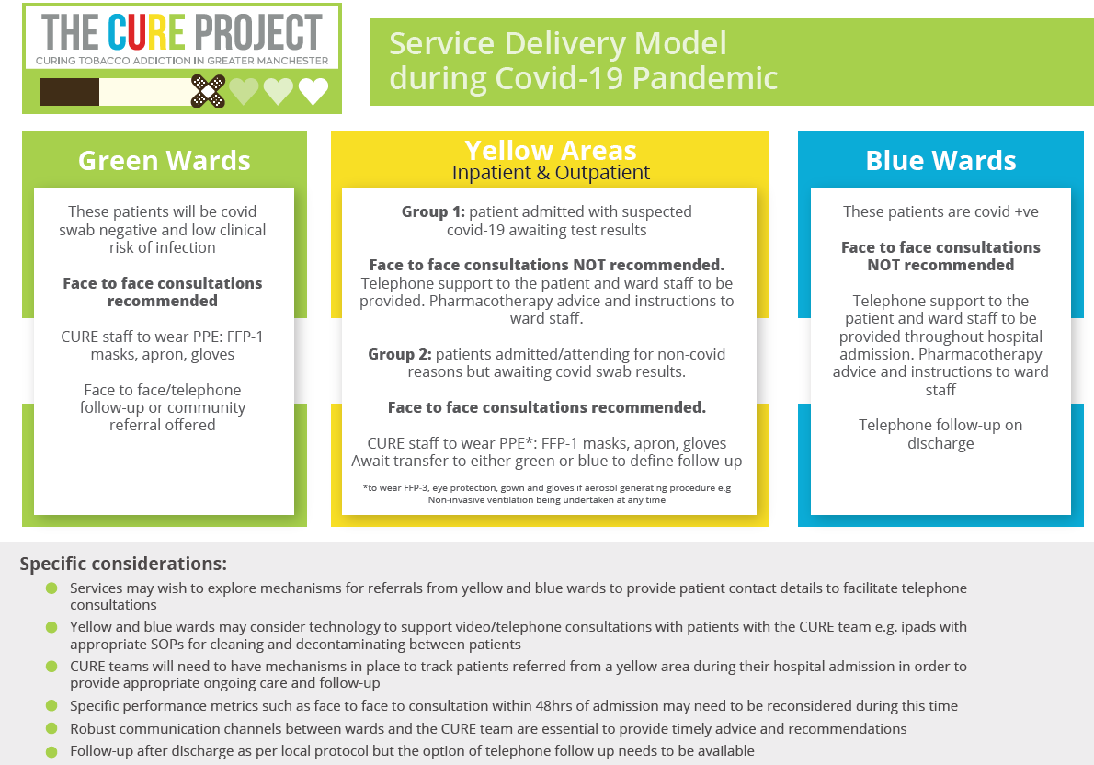
Updated Service Model – COVID 19

Slide 6
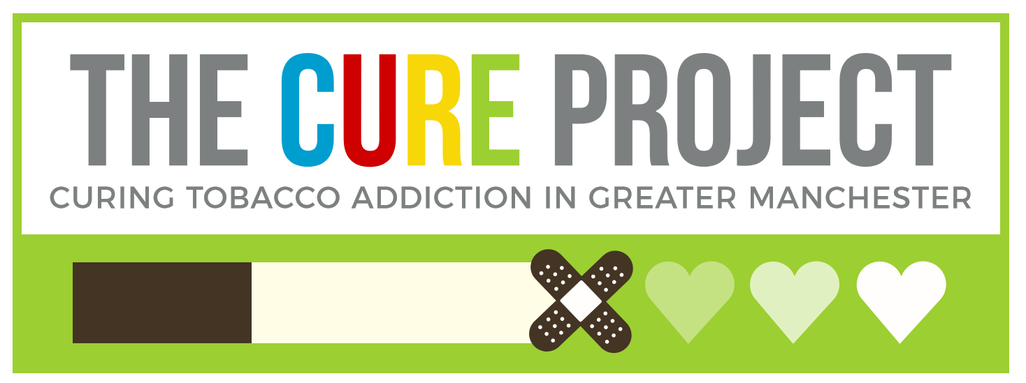
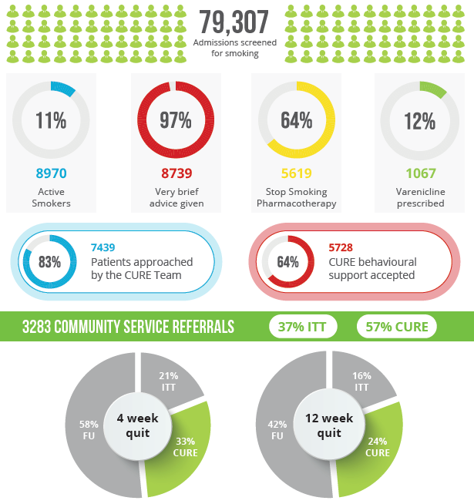
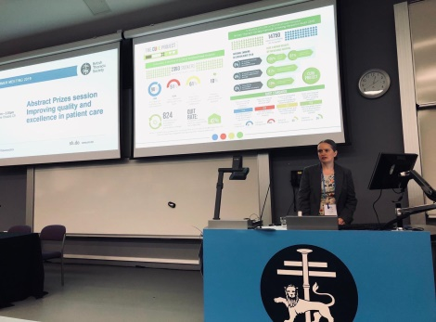
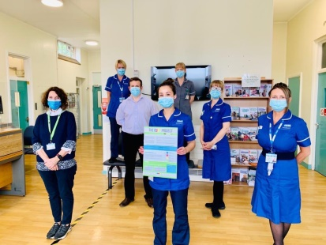
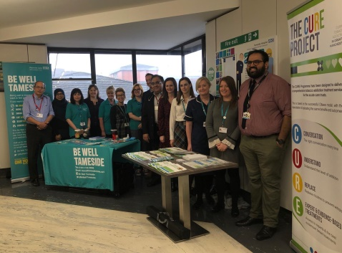
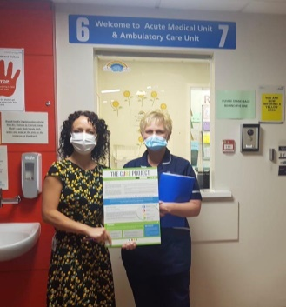
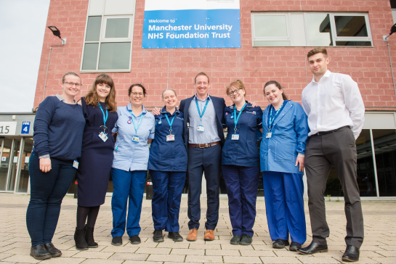
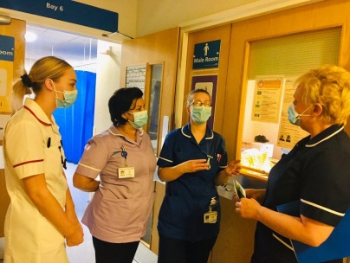
Wythenshawe Hospital (pilot site) outcomes – Oct 2018 to Feb 2021

Slide 7
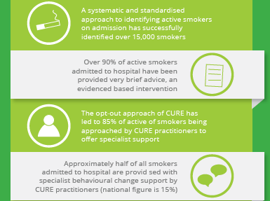
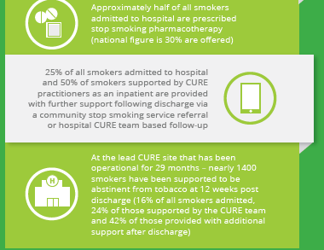

Headline Success of CURE in GM – 2019-2021

Slide 8

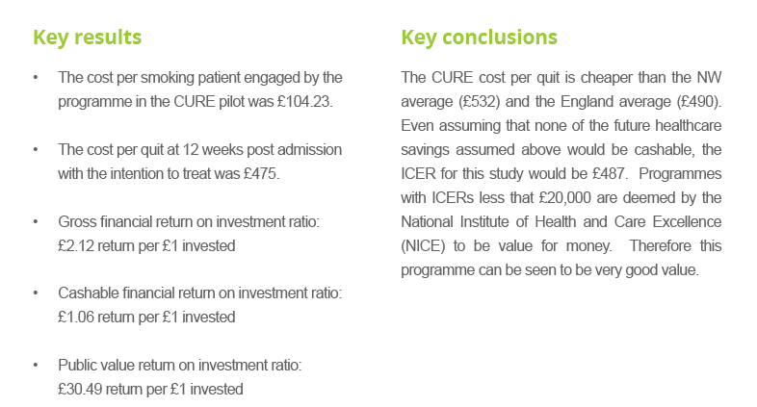
Evaluation
All Provider’s that have launched the CURE service are monitoring a set of standard key performance indicators including:
Recording of smoking status
Offer of VBA & medication on admission
Acceptance of specialist support
Quit status (4 and 12 week)
  Community service follow up
Pharmacotherapy costs
We have also completed the following as part of the rollout of CURE in GM:
Behavioural Analysis - how to implement a new treatment pathway successfully
GM wide staff survey – understanding the barriers to smokefree sites

Slide 9
Any questions?
Massive thank you to everyone for their input into the delivery of the CURE project in GM and beyond
© Copyright Greater Manchester Cancer. All rights reserved.

